Slide 1


CHINOOK
MUSIC STORE PROJECT
Lukose Jacob
22ⁿᵈ July 2025

Slide 2



INTRODUCTION
Chinook operates in a dynamic music market where customer tastes evolve quickly and competition is fierce.
Despite having a rich catalog and loyal customers, we risk leaving revenue on the table without understanding who buys what, where, and why.
The physical music market remains a valuable opportunity but is challenged by fragmented preferences, high churn, and regional differences.
Data-driven insights can help Chinook identify high-value customers and markets, align promotions to preferences, and improve retention and sales.

Slide 3


THE WHAT
PROBLEM STATEMENT
Analyze music record sales data to gain insights and make recommendations for the company's strategy in the physical music market.
OBJECTIVES
Identify top-performing products, genres, and customer segments.
Understand churn and retention patterns across regions.
Profile customers by value, engagement, and geography.
Discover product affinities for bundling and cross-selling.
Recommend actionable strategies to increase sales, loyalty, and customer lifetime value.

Slide 4

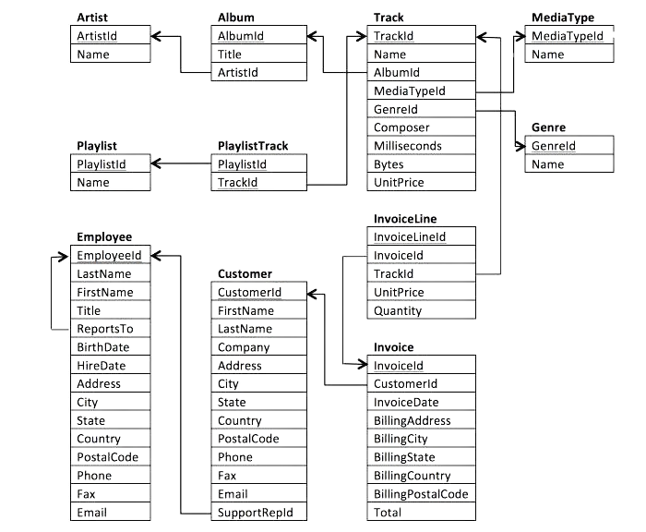
DATA SNAPSHOT
Key Data Sources:
Customer Table: Customer profiles and locations.
Invoice Table: Purchase transactions and amounts.
Invoice Line Table: Tracks purchased in each invoice.
Track, Album, Artist, Genre Tables: Product catalog — to link purchases to specific tracks, albums, genres, and artists.
Scope:
Global sales data across multiple countries and cities.
Focus on customer purchases, product preferences, and regional performance.
Timeframe: up to 31-Dec-2020.
Analysis emphasizes USA as the primary market while also
comparing other regions.

Slide 5


METHODOLOGY
The methodology combined thorough data cleaning, robust query techniques, and clear visual storytelling to ensure actionable results. The analytical flow followed the path:
Data Validation → Metric Definition → SQL Analysis → Visualization & Insights
Data Exploration & Validation
Key Metrics Defined
SQL
Analysis
Visualization
Reviewed schema and relationships across tables.
Checked for missing, duplicate, or inconsistent records.
Sales
Customer churn
Lifetime value
Product affinities
Regional trends.
Wrote advanced SQL queries using:
Common Table Expressions (CTEs)
Window functions (e.g., NTILE, RANK, ROW_NUMBER)
Aggregations and joins.
Created clear tables and charts to illustrate findings.

Slide 6
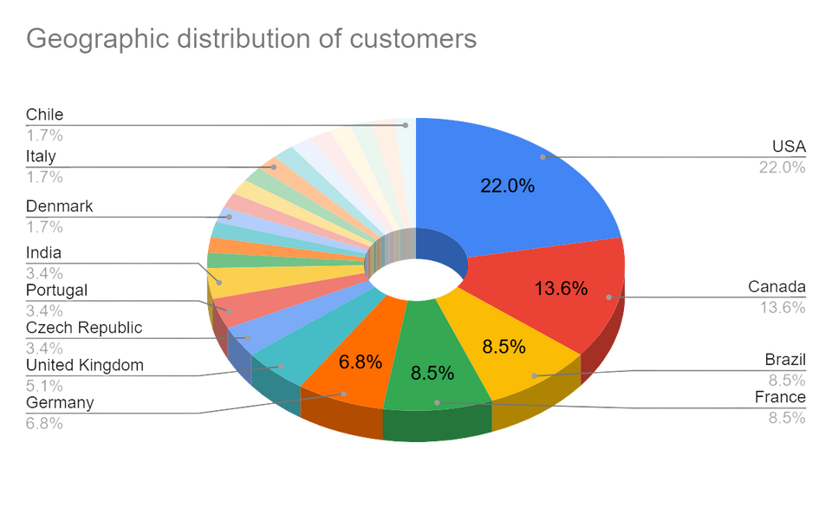
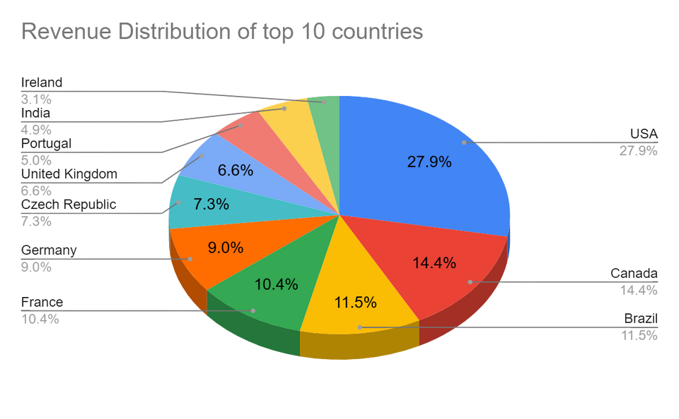
GEOGRAPHIC DISTRIBUTION
Now that we understood what the data is lets try to identify where are our customers currently located?
Out of the 59 customers, the majority are concentrated in the USA, followed by significant numbers in Canada, Brazil and France, with smaller clusters in several other countries.
The USA leads Chinook’s customer base with the highest revenue of $1,040.49 from 131 invoices, followed by Canada and Brazil with notable contributions of $535.59 and $427.68, respectively.

Slide 7
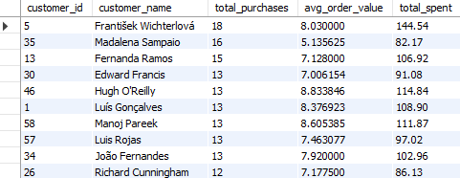
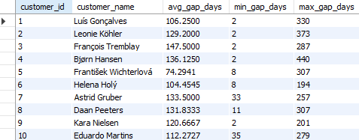
Customer Purch
asing Behaviour
Total Spend & AOV
Purchase Frequency
Most customers make 8–13 purchases, with AOV between $7–$9, indicating steady and uniform spending habits.
Some customers (e.g., Robert Brown) have high AOV despite fewer purchases, reflecting premium spending tendencies.
Customer base overall is stable and predictable, suggesting opportunities to engage high-AOV customers more deeply and increase purchase frequency among lower-frequency segments.
Average gap between purchases: ~100–150 days — shows infrequent, periodic buying.
Minimum gap: as low as 1–8 days — occasional bursts of activity.
Maximum gap: can exceed 900 days — long periods of inactivity in some cases.
Indicates irregular purchasing behavior, with scope to reduce dormant periods and foster more consistent engagement.

Slide 8

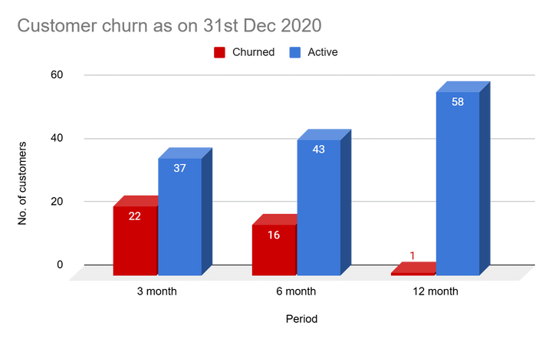
CUSTOMER CHURN RATE
Once we understood customers and their purchasing behavior, the next step was to identify WHO is leaving and what can be the potential reasons behind this.
Churn defined as no purchase in the past 3, 6, or 12 months (as of 31-Dec-2020).
Calculated churn rates across different time windows to assess customer retention risk.
Observations:
3-month churn: ~37% of customers inactive.
6-month churn: ~27% of customers inactive.
12-month churn: ~1.7% of customers inactive.
Most customers make at least one purchase within 6–12 months, but a significant portion (~37%) disengages in the short term.
While long-term retention is strong (nearly all customers return within 12 months), short-term disengagement is notable.
Indicates opportunity to increase engagement frequency and reduce early-stage churn.

Slide 9
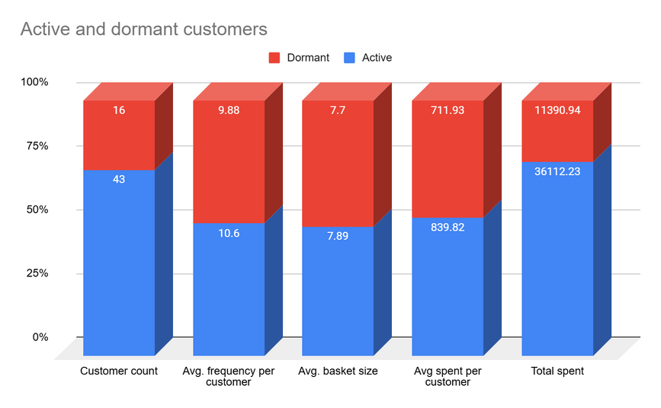
ACTIVE vs DORMANT
How We Defined Customers:
Active: Last purchase in the last 6 months of 2020.
Dormant: Last purchase before July 2020.
Active customers are more frequent, have slightly larger baskets, and spend significantly more than dormant customers.
Active customers contribute more than three times the total revenue compared to dormant customers.
Dormant customers still show moderate engagement potential, especially those with historically high spend.
Maintain & reward Active customers to sustain their high engagement.
Target Dormant customers with win-back campaigns and personalized offers.
Prioritize reactivating dormant customers who were historically high spenders.
Explore loyalty programs to increase frequency & basket size among both groups.

Slide 10

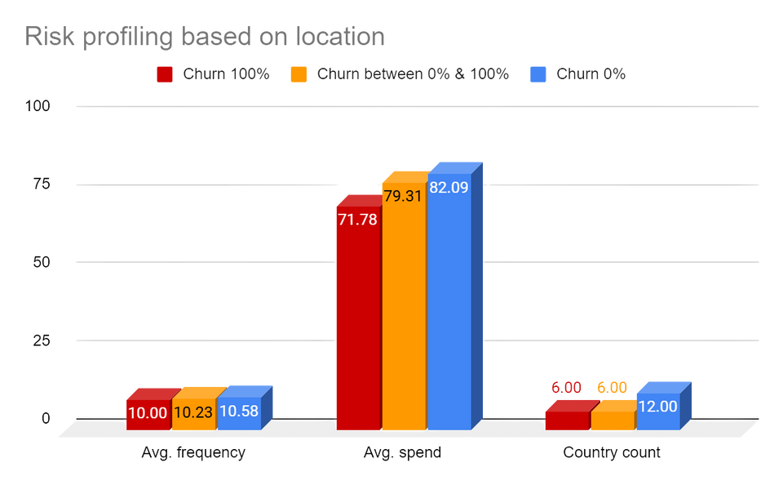
Profiled risk based on:
Location (country & city)
Purchase history: frequency, recency, and spending
Defined high-risk customers as those with:
High churn likelihood (inactivity > 6 months)
Low frequency & low spending
Located in regions with historically high churn
CUSTOMER
RISK
PROFILING
Smaller regions show both low spending & high churn indicating → risky and low ROI.
Medium-sized, high-spending regions (Germany, France) still show high churn → opportunity to improve retention.
Customers in stable, high-value regions are highly engaged & lower risk.
Prioritize retention campaigns in Germany & France high potential, but at risk.
Run reactivation campaigns with incentives in small, high-churn regions to test cost-effectiveness.
Regularly monitor low-frequency, low-spending customers and regions with high churn to adjust marketing strategy.

Slide 11
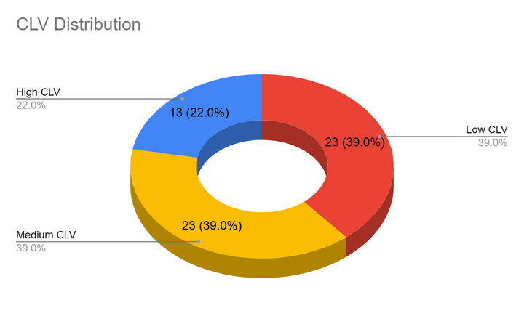
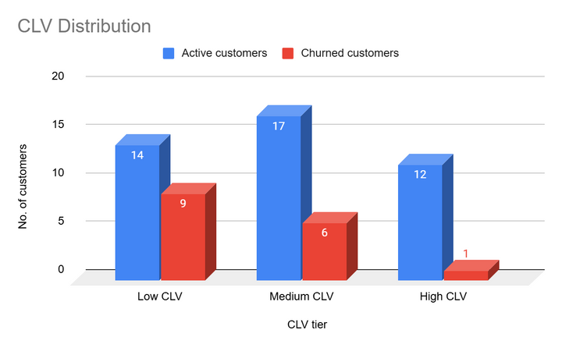
Customer Lifetime Value
Computed composite CLV score based on:
Tenure (loyalty/duration)
Total invoices (engagement/frequency)
Annual revenue (monetary value)
Normalized each metric using NTILE(4)
Assigned customers to CLV tiers:
High CLV: score ≥ 10
Medium CLV: 7–9
Low CLV: < 7
Insights
High CLV customers are far more likely to remain active, with over 92% still engaged.
Medium CLV customers show a moderate churn rate (about 26%), indicating some risk but also good retention potential.
Low CLV customers have the highest churn rate (nearly 39%), suggesting weaker loyalty and higher disengagement risk.
There is a clear inverse relationship between CLV tier and churn: higher-value customers are more loyal and less likely to churn.
Suggestions
High CLV: Maintain with loyalty programs, premium offers, personalized recognition.
Medium CLV: Targeted campaigns and upsell opportunities to move them into High CLV.
Low CLV: Selectively re-engage churned customers with low-cost incentives and monitor ROI.

Slide 12
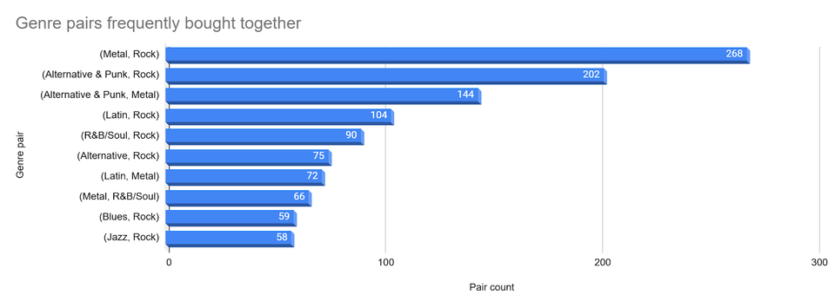
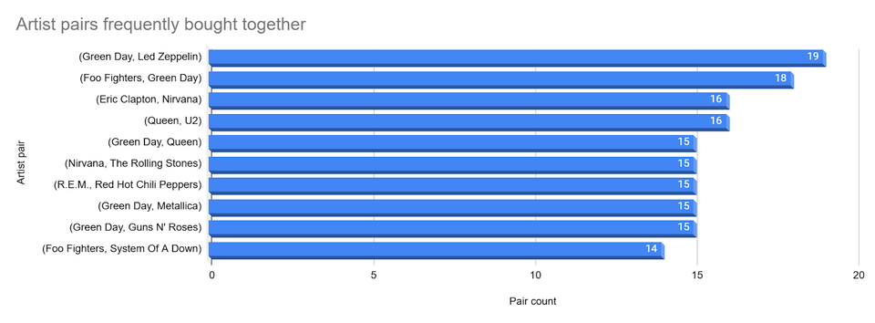
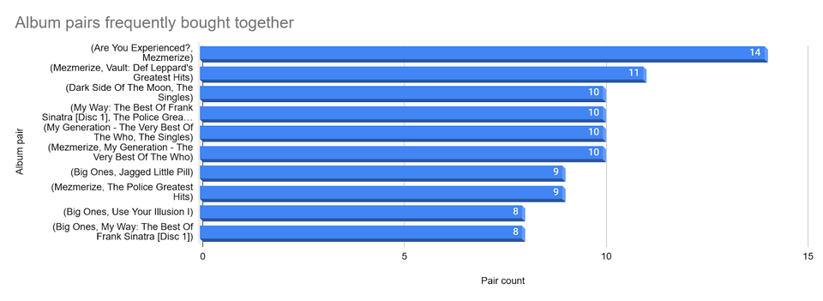
Product Affinity
Examined invoices as “baskets” of purchases to find which genres, artists, and albums are frequently bought together.
Identified strong co-occurrence patterns to inform bundling, recommendations, and cross-selling campaigns.
Key Findings:
Genres:
Rock pairs frequently with Alternative & Punk, Metal, and even Latin & Jazz — showing broad cross-genre appeal.
Artists:
Green Day often purchased with Led Zeppelin, Foo Fighters, Queen, and Metallica — strong cross-artist interest.
Albums:
Mezmerize, Are You Experienced?, and Vault: Def Leppard’s Greatest Hits frequently appear together — suggesting bundling opportunities.
Customers tend to buy complementary genres and artists, particularly within the broader Rock and Alternative space.
Certain albums and artists act as bridges across genres, indicating strong cross-selling potential.

Slide 13
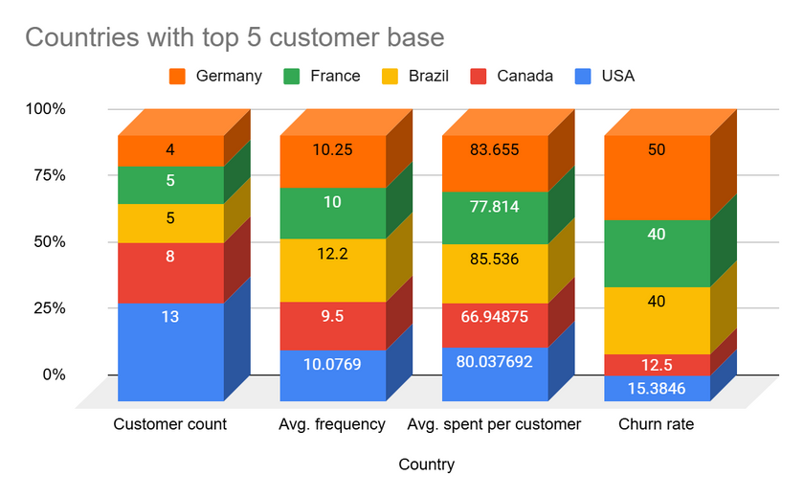
REGIONAL MARKET ANALYSIS
Examined customer behavior at the country level, focusing on:
Average purchase frequency.
Average spend per customer.
Churn rate (inactivity > 6 months).
Classified customers as Active or Churned as of 1-Jul-2020.
Insights:
USA & Canada are stable core markets with reliable engagement.
European countries show higher churn despite good spending, an opportunity to improve retention.
Tiny regions with only one customer and 100% churn suggest low priority but worth small reactivation tests.
Some smaller but loyal markets (Czech Republic, India, etc.) show strong retention & spending, prime for nurturing.

Slide 14





Building a Data-Driven Strategy
This analysis is structured around three key pillars, providing a comprehensive understanding of Chinook’s business:
CUSTOMER
PRODUCT
LOCATION
Who buys, how much, and how often?
Loyalty, churn risk, CLV tiers, and engagement patterns.
Insights on Active vs Dormant segments.
What sells well, and what sells together?
Product affinity across genres, artists, and albums.
Opportunities for bundling and cross-selling.
Where does demand come from?
Regional performance, loyalty, churn, and economic nuances.
Tailoring strategy to regional behaviors and potential.

Slide 15




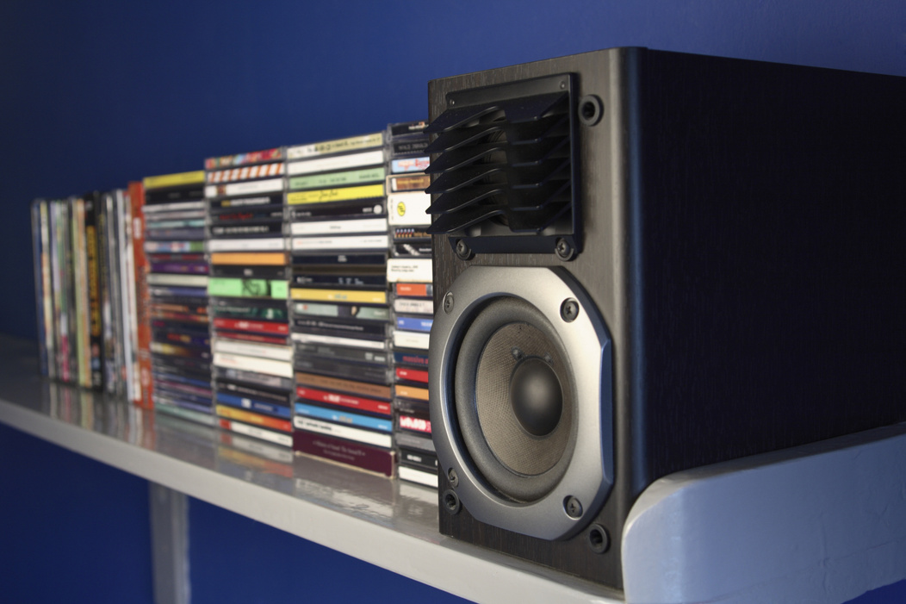

Strategic Recommendations
CUSTOMER
Retain High CLV customers with loyalty rewards and personalized offers.
Target Medium CLV customers with campaigns to move them up the value ladder.
Win-back Dormant and churned customers selectively, focusing on those with past high value.
Reduce dormant periods by encouraging consistent engagement.
Mission
PRODUCT
Promote Rock, Alternative & Punk, and Metal albums in the USA aligned with top preferences.
Bundle high-affinity albums & artists into attractive offers.
Feature cross-genre playlists & recommendations based on observed affinities.
Mission
LOCATION
Strengthen retention in high-value but high-risk regions (Germany, France, UK).
Maintain loyalty programs in stable regions (Czech Republic, Ireland, India).
Test low-cost reactivation campaigns in small, high-churn markets.

Slide 16
CONCLUSION
Chinook has a strong foundation: loyal high-value customers, a rich catalog, and clear demand patterns.
The analysis shows that Customer, Product, and Location are interconnected levers to drive growth.
Data reveals actionable opportunities to:
Retain and grow High CLV segments.
Boost sales with smarter product positioning and bundling.
Tailor strategies to regional nuances.
Marketing spend can now be allocated more effectively - focusing where impact is greatest.
This data-driven approach ensures Chinook stays competitive and aligned with evolving customer needs.
By listening to the data and acting strategically, Chinook can transform insights into stronger customer relationships, higher sales, and long-term success.

